Slide 1








EMOTION DETECTION
WITH TEXT
Presented by:
Madulika Prabusankar
813821243033
Saranathan College of Engineering

Slide 2

AGENDA
Problem statement
Project overview
End users
Solution and value proposition
Process flow
Solution
Models
Model architecture
Result

Slide 3


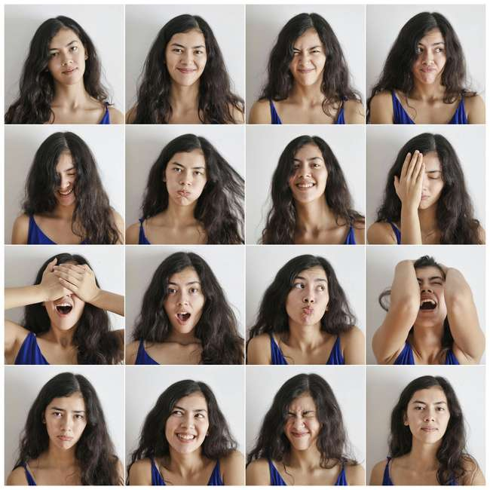

Problem statement
The problem statement revolves around developing a machine learning model capable of accurately classifying emotions expressed in textual data. This involves preprocessing text, training various classifiers, and evaluating their performance. The objective is to provide a effective solution for emotion detection, with potential applications in sentiment analysis, customer feedback analysis, and mental health assessment.

Slide 4

Project Overview
This project aims to develop a machine learning model that accurately classifies emotions based on textual data. Leveraging natural language processing (NLP) techniques and machine learning algorithms, the goal is to provide a reliable solution for emotion detection.

Slide 5

End User
Companies seeking to analyze customer sentiment in online reviews and feedback.
Mental health professionals looking to assess the emotional state of individuals based on their text-based communications
Social media platforms interested in automatically categorizing user posts and comments for content moderation and sentiment analysis.

Slide 6


Solution and Value Proposition
The solution involves preprocessing textual data to clean, tokenize, and convert it into numerical features using TF-IDF vectorization. Various machine learning models, including Random Forest Classifier, Support Vector Machine, Multinomial Naive Bayes Classifier, Gradient Boosting Classifier, and Logistic Regression Classifier, are trained on the preprocessed data. The value proposition lies in providing an accurate and reliable tool for emotion detection, which can aid in sentiment analysis, customer feedback analysis, and mental health assessment, thereby enabling businesses and professionals to make informed decisions.

Slide 7

Process Flow
Data Collection:
Obtain a dataset containing textual data along with
corresponding emotion labels.
Text Preprocessing:
Clean the text data by removing noise, punctuation, and special characters. Tokenize the text and convert it into numerical features using TF-IDF vectorization.
Model Training:
Train various machine learning models on the preprocessed data, including Random Forest Classifier, SVM, Naive Bayes, Gradient Boosting, and Logistic Regression.

Slide 8
Model Evaluation: Evaluate the performance of each trained model using metrics such as accuracy, precision, recall, and F1-score.
Visualization and Analysis: Conduct exploratory data analysis (EDA) to gain insights into the dataset. Create visualizations such as word clouds and TF-IDF score distributions to understand the structure and characteristics of the text data

Slide 9

Solution
The solution involves developing a machine learning model capable of accurately classifying emotions expressed in textual data. By preprocessing the text, training various classifiers, and evaluating their performance, the goal is to provide a reliable tool for emotion detection.

Slide 10


Models
The project utilizes various machine learning models, including:
Random Forest Classifier
Support Vector Machine (SVM) Classifier
Multinomial Naive Bayes Classifier
Gradient Boosting Classifier
Logistic Regression Classifier

Slide 11
Model Architecture
Each machine learning model is trained on the preprocessed data, consisting of TF-IDF vectors representing the text features. The models are evaluated using classification metrics such as accuracy, precision, recall, and F1-score to assess their performance in emotion detection.

Slide 12
RESULTS
The project aims to deliver accurate and reliable emotion detection models that can effectively classify emotions expressed in textual data. Through thorough evaluation and analysis, the goal is to provide valuable insights and tools for sentiment analysis, customer feedback analysis, and mental health assessment.

